Slide 1
Vaccine Preventable Diseases in California Counties
Group Members: Clay Franklin, Elise Miller,
Gabbie Cutaiar, Rachel Snarr

Slide 2
Mission
To determine a correlation between population trends and the number of occurrences of vaccine preventable diseases in California counties.

Slide 3
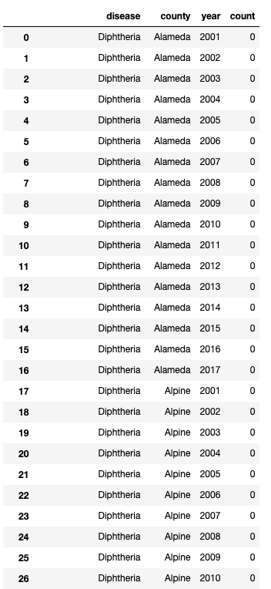
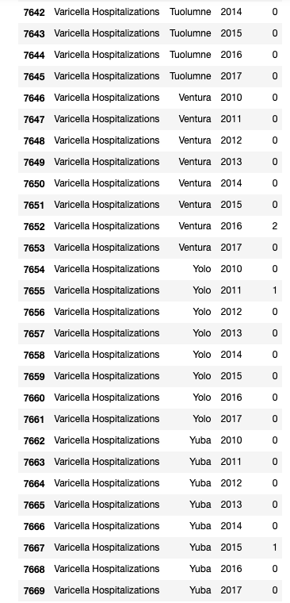
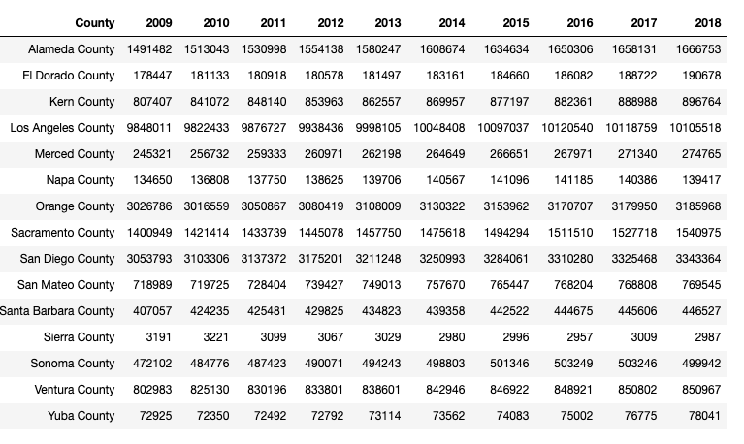
Our starting data
Disease Count Per County Per Year
Total Years: 17
Every vaccine preventable disease
Extremely Large Datasets
Population per county over time
Total Counties: 58

Slide 4
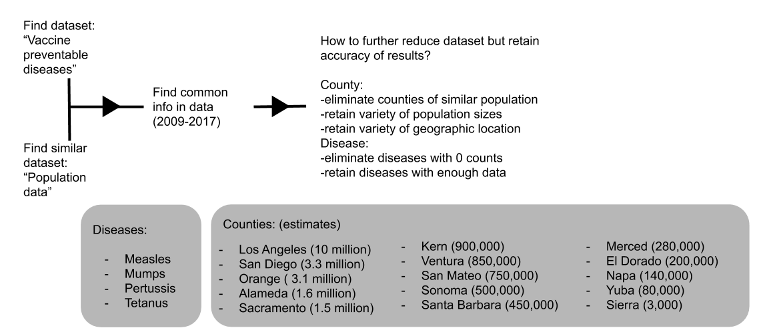
Our process - Step 1: Find data, reduce to manageable size

Slide 5
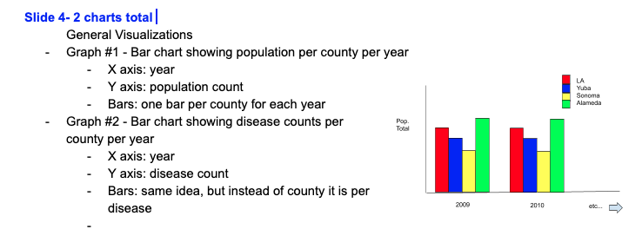
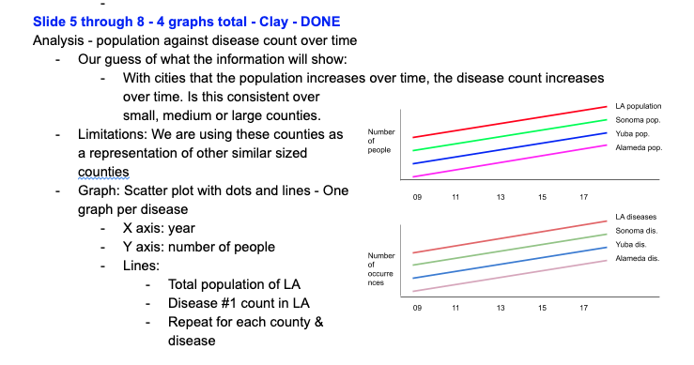
Our process - Step 2: Assign analysis work evenly
A- Create list of graphs we want to create
B- Order list of graphs logically
C- Assign sections of work evenly
D- Complete work separately
E- Push to Github

Slide 6
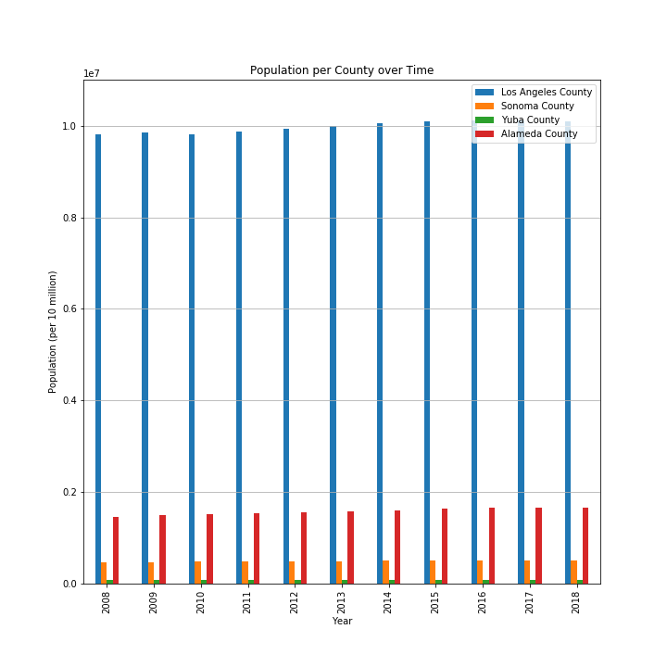
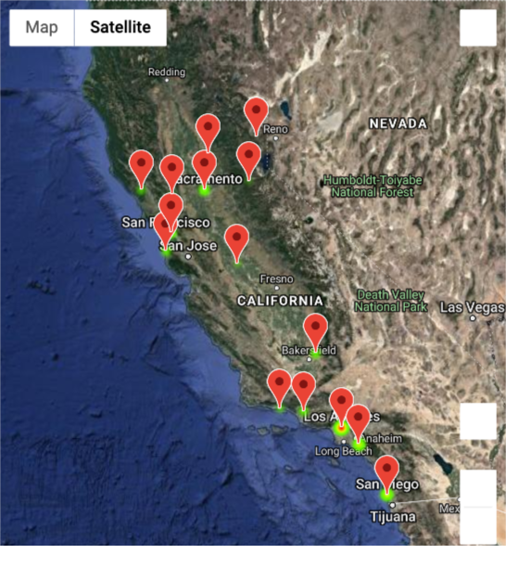
Population Count Overview
2017

Slide 7
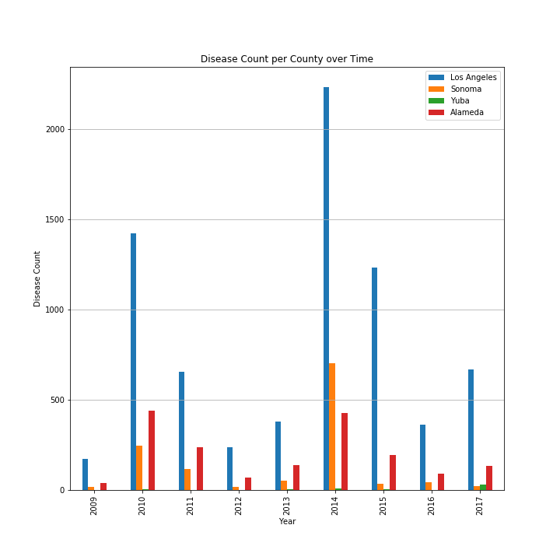
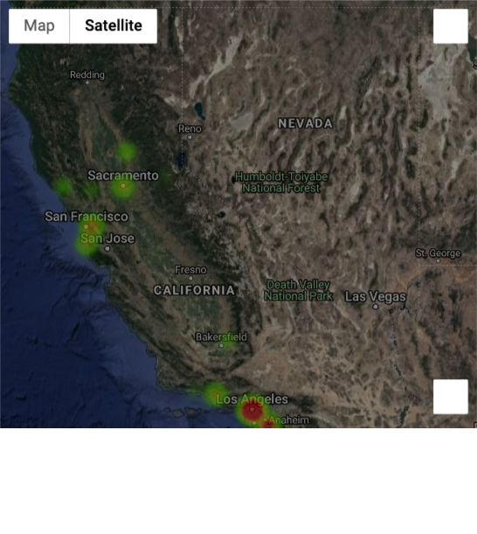
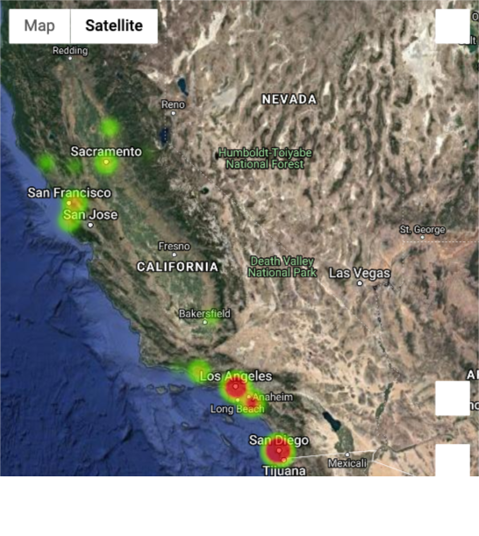
Disease Count Overview
2017

Slide 8
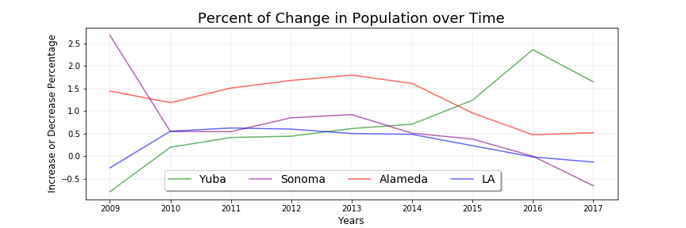
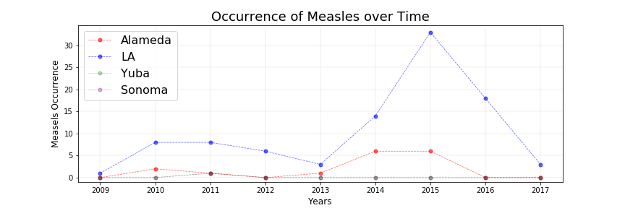
Population Total & Measles Occurrences Over Time
Trend lines
Hypothesis: As population increases, disease count increases.
Limitations: Chose one county of each size (sm, med, lg, xl) to represent all counties of similar sizes

Slide 9
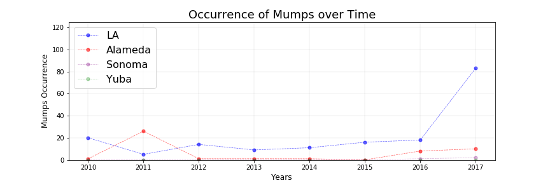
Population Total & Mumps Occurrences Over Time
Trend lines
Hypothesis: As population increases, disease count increases.
Limitations: Chose one county of each size (sm, med, lg, xl) to represent all counties of similar sizes

Slide 10
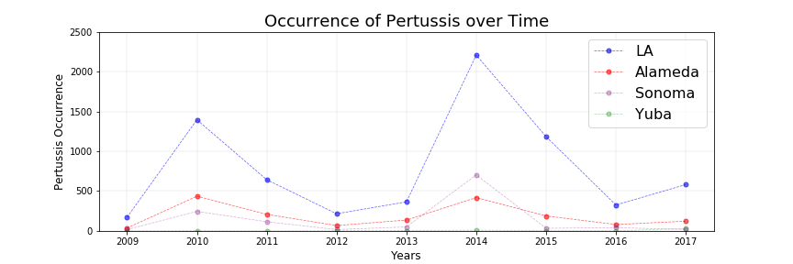
Population Total & Pertussis Occurrences Over Time
Trend lines
Hypothesis: As population increases, disease count increases.
Limitations: Chose one county of each size (sm, med, lg, xl) to represent all counties of similar sizes

Slide 11
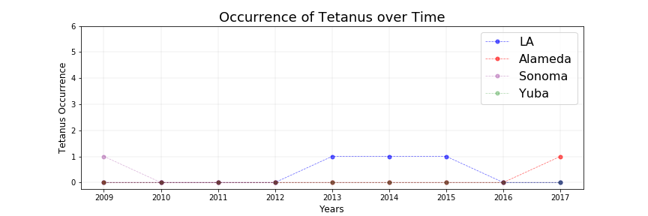
Population Total & Tetanus Occurrences Over Time
Trend lines
Hypothesis: As population increases, disease count increases.
Limitations: Chose one county of each size (sm, med, lg, xl) to represent all counties of similar sizes

Slide 12
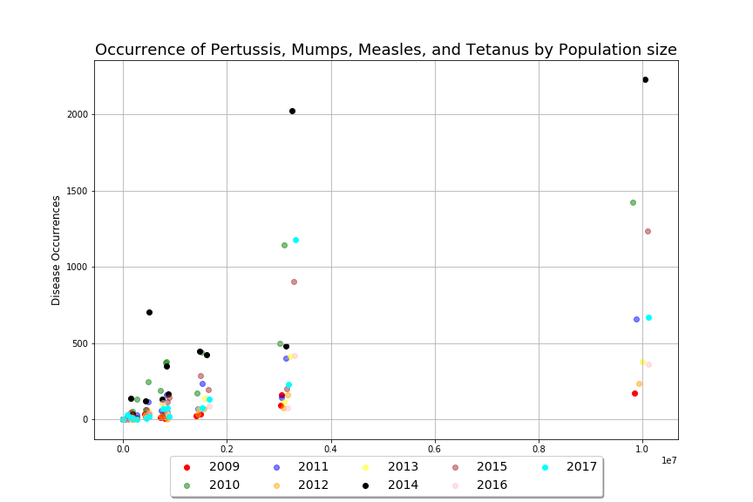
Population Total & Occurrences
Hypothesis: As population increases, disease count increases.
Disease counts trend upwards as population increases.

Slide 13
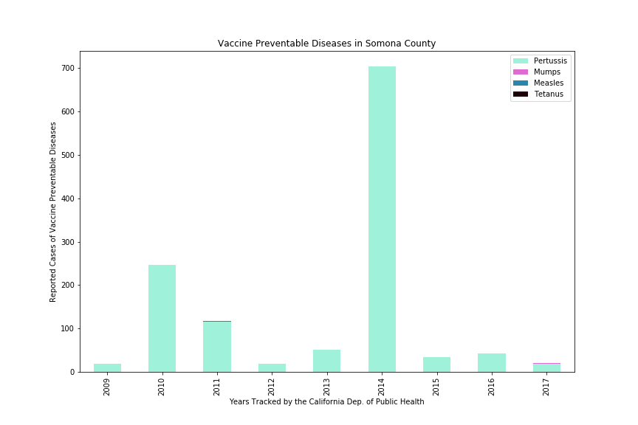
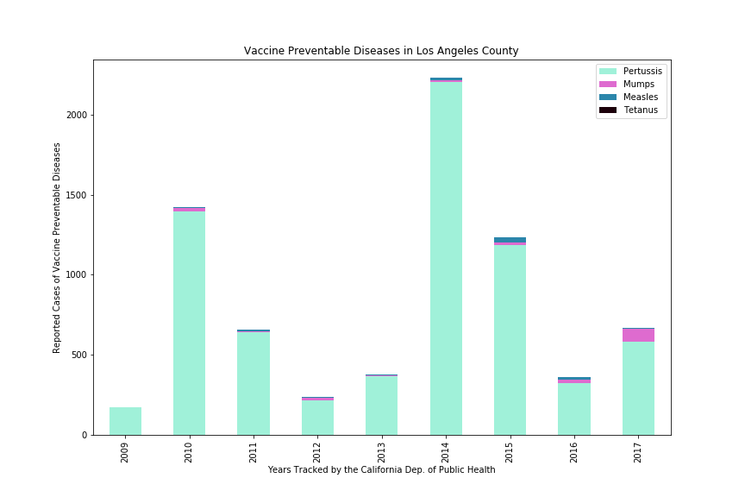
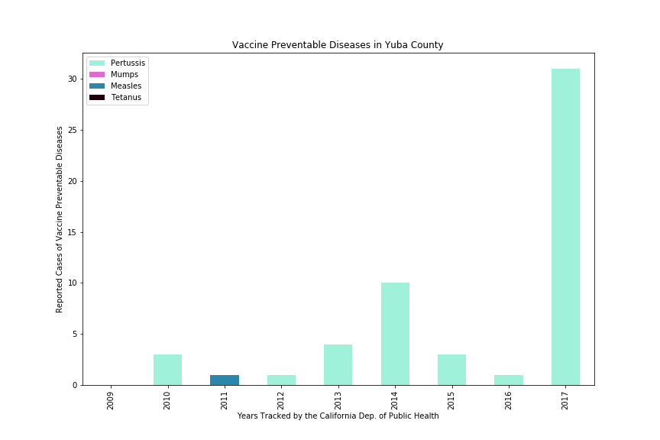
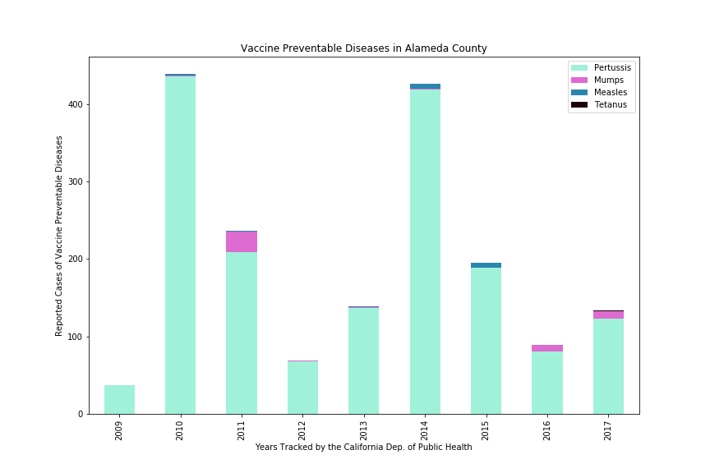
Disease Count Breakdown Over Time
Per County
How much of the total disease count is made up of each disease?
Is the total disease count in this county consistent?

Slide 14
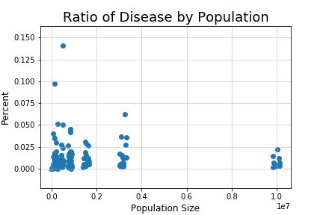
Critical Analysis: Is our set representative of other similar sized counties in California?
All years & all counties
Limitations: Population is the only factor taken into account.
County population density and square mileage were not.

Slide 15
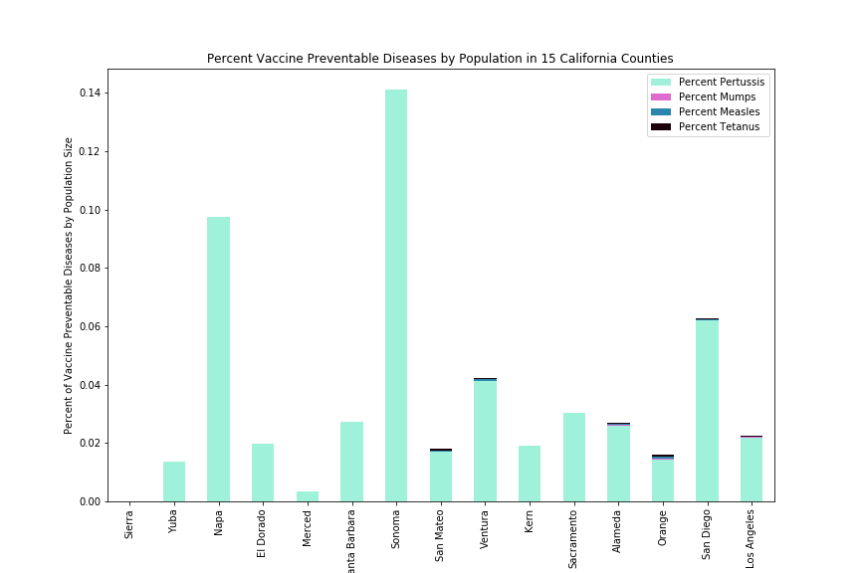
Critical Analysis: Is our set representative of other similar sized counties in California?
2014 data
Limitations: Population is the only factor taken into account.
County population density and square mileage were not.

Slide 16
Conclusion
Other analysis that could be done
Categories in population:
Ethnicity
Age
Gender
Poverty level
Education
Density
And more
Spread of disease
Access to healthcare
Social media influence
Immigration/proximity to border
All counties in California
Similar sized counties in other states
Geographical environments
Predictive Analysis

Slide 17


